Slide 1
AER Cycle 501 Summary
6/12/23

Slide 2
Lessons
Successfully and reproducibly angle-encoded the beam.
Beating pattern suggests angular structure in the beam (spatial structure already known)
Need to account for this next cycle
The wide-angle failed due to scratched side films and maybe a bad hypotenuse film
AER is very sensitive to the orientation of optical components: the s-bender channels must be parallel to the encoding direction and the v-cavity “V” must be horizontal
SEMSANS is sensitive to s-bender direction, but not v-cavity direction

Slide 3
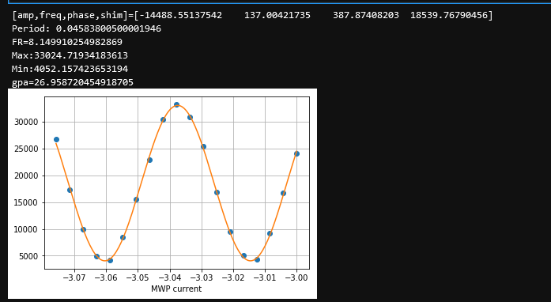
MWP Gauss/amp measurement
Precession mode current scan with the triangles in same direction to get the gpa of each triangle
Simulation predicts 35 gpa but always see lower

Slide 4
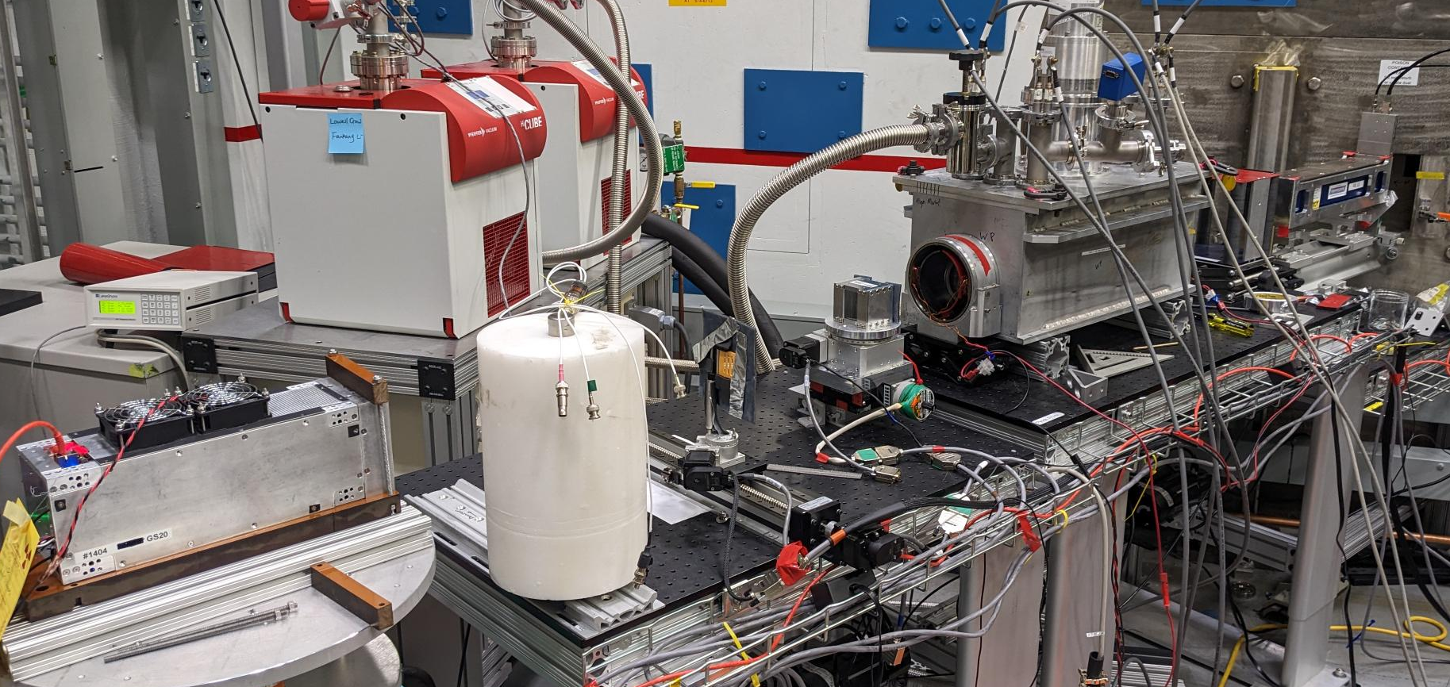
Experimental setup photo
Here is the final setup after a few initial false starts.
Originally wanted the camera to be on the bench after the goniometer, but resolution was too low.
Also tried the camera right after the sample, but imaging resolution was too high for a good demonstration of AER
The He detector was used for initial alignment and MWP gpa

Slide 5
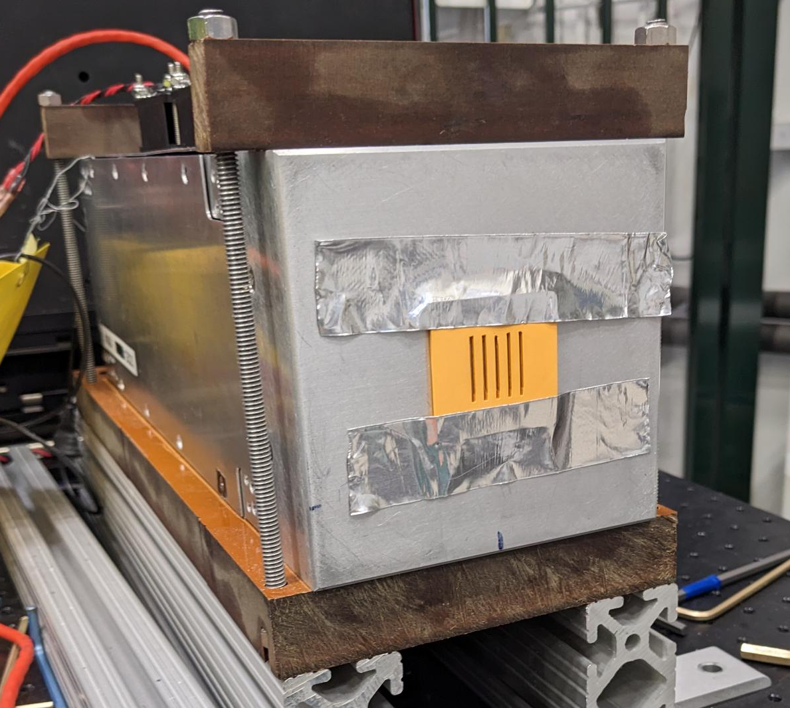
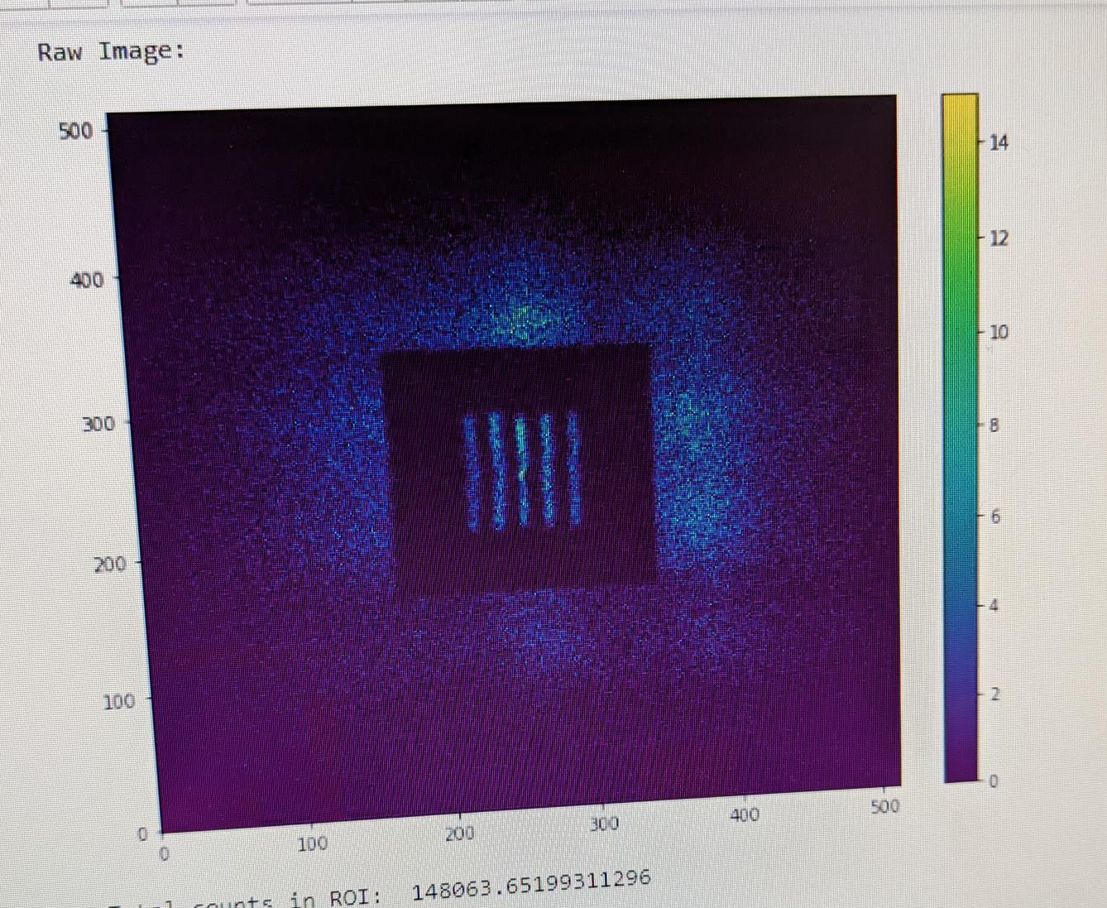
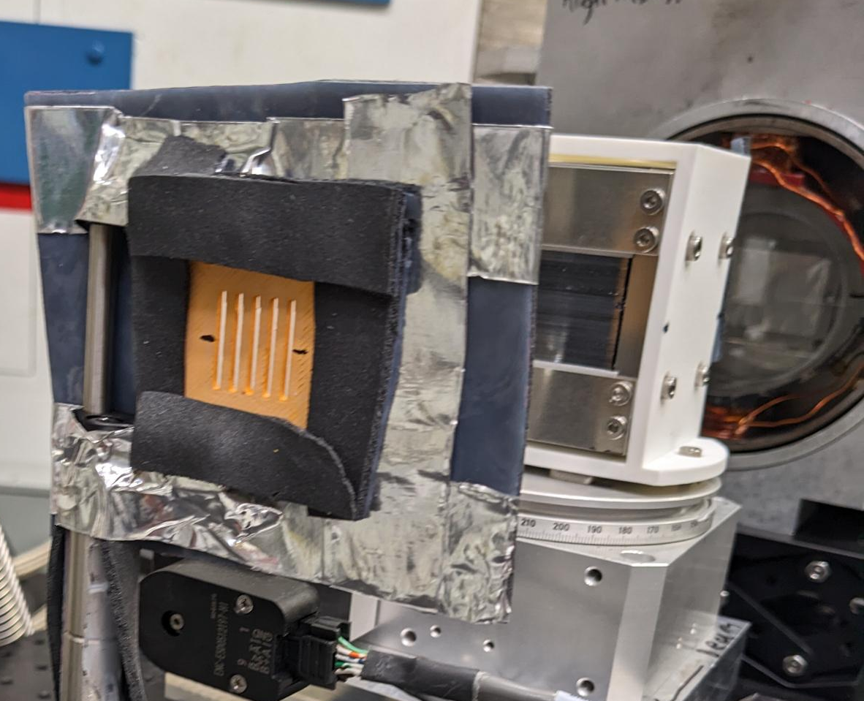
Sample used
Neutron absorbing grating:
5 slits 2mm wide, 50% duty factor.
Thick enough to completely kill the flux.
Also confirmed the 4mm and 1mm slits killed the flux, but did not have enough time to do AER scan.
Neutron absorbing rubber surrounded the sample.

Slide 6
5/27 Wide-angle Woes
Wide-angle failed in flipping mode
Turned out to be some bad films in the downstream MWP
Switched to MWP for the remainder of the experiment

Slide 7
Rotating the s-bender

Slide 8
Rotating the v-cavity

Slide 9
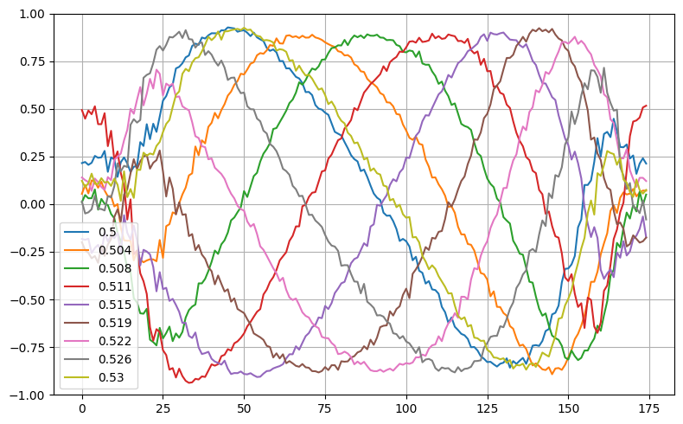
6/5 Start of the good data
Starting on
Monday 10:00 pm
Scan 12536
Vertically integrated polarization vs pixel
(1 px = .227 mm)
Empty beam phase scan in AER mode with 1 amp in MWPs.
Scanned the center guide field by 2pi.

Slide 10
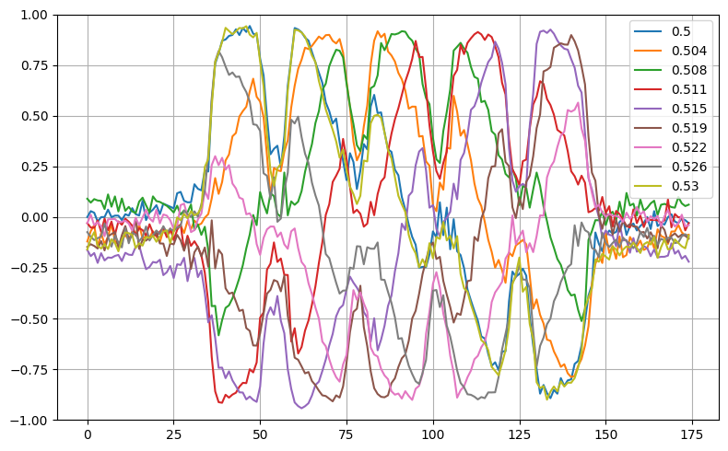
Sample in beam with 1 amp in MWPs.
The imaging resolution was too high for a nice proof-of-principle experiment: can see the image of the grating in the polarization.

Slide 11
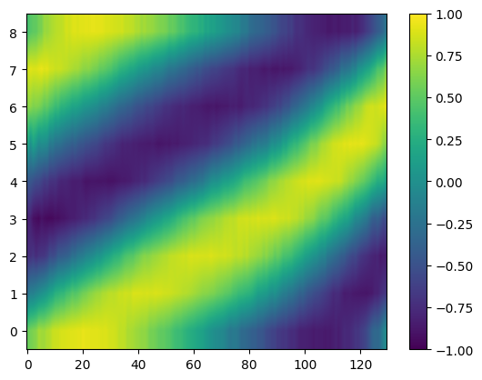
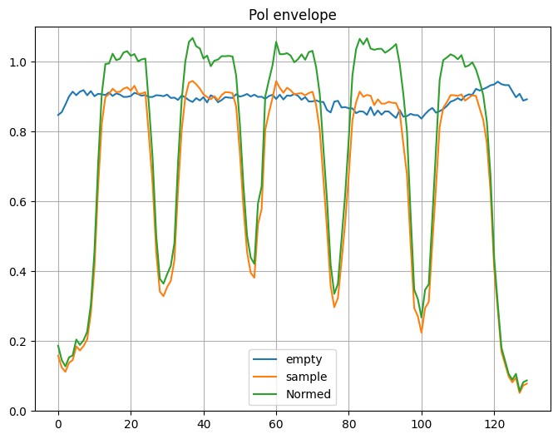
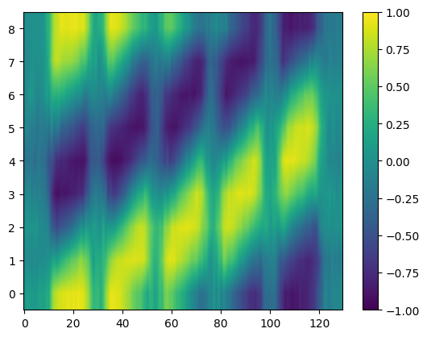
MWP 1 amp reconstruction

Slide 13
Plans for AER in cycle 502
Design mount for Timepix3 on goniometer
Design collimator to ensure uniform
Print grating with a period that is smaller than the “intrinsic D/L ratio” of the angular structure of the beam
Move camera back to artificially reduce imaging resolution?
Use Timepix3 instead of Anger camera?
Adjust the monochromator to get rid of the beating?
Try a diffuser to spread out the beam?
Glassy carbon
Graphite again?
Diffuser from CG1D (nanoparticle?)

Slide 14
McStas simulations to do
Model the misalignment of the monochromator
Need the full CG4B assembly file to accurately model
Idealized versions of the experimental data for comparison
Simulations with different slit sizes and positions

